Slide 1
Vicuna FPU Design Survey
Driving Innovations™
Eric Chen
2018-01-12

Slide 2
Outline
FP Instructions List
Modify Graywolf FPU design
MAC instr:
Mul done at F2, CSA-to-SM at F3, pipe to F1 for addition -> F3
Adopt multiple pipeline
Divide MUL module into two stages => || MUL1 || MUL2 ||
Divide Add-and-round into two stages => || Add || Round ||
Using Signed Digit MAC FPU design
Signed Digit Number System: Carry propagating free
Add, Mul, Mul-Add-Fused by SD NS
Use original DSU (added by CSA)
Needed unit: SD-MUL, SD-Adder, SD-to-SM, SD normalization

Slide 3
FP Instruction List
FP Register Files and fcsr implementation
FP Load/Store instructions
FP Conversion and Move Instructions
FP Compare Instructions
FP Classify Instruction
FP Computation instructions
FADD, FSUB, FMUL, FDIV, FSQRT, FMIN-MAX
FMADD, FMSUB

Slide 4
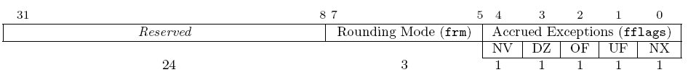
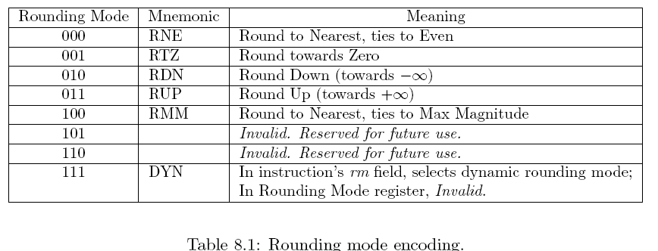
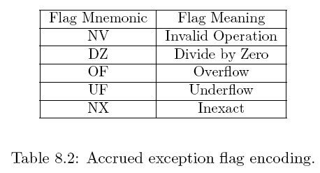
The fcsr

Slide 5
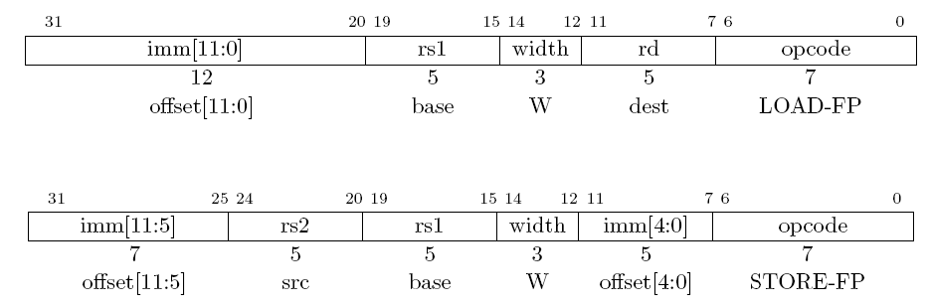
Single-Precision FP Load and Store Instructions
Single-Precision FP Load and Store Instructions

Slide 6
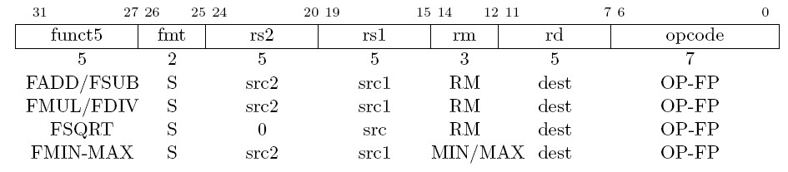
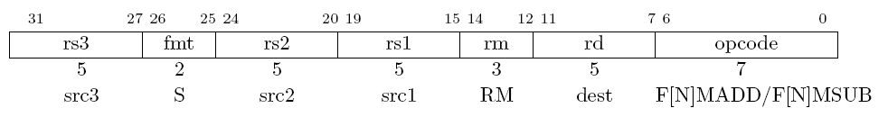
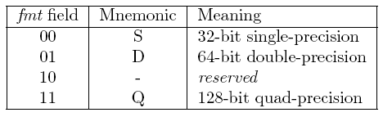
Single-Precision FP Computation Instructions
Single-Precision FP Computation Instr.
Half format only for storing
Half only be supported under V standard

Slide 7
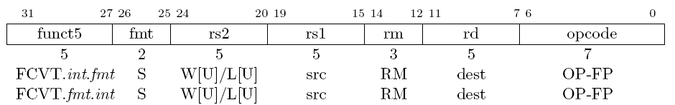
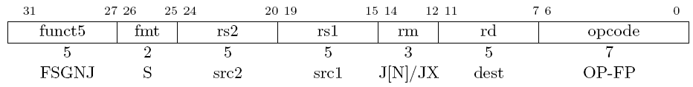
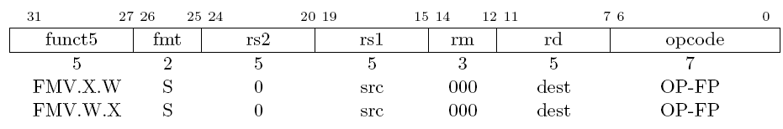
Single-Precision FP Conversion/Move Instructions
Single-Precision FP Conversion/Move Instr.
FSGNJ: sign-injection
FMV.X.W: move bit pattern

Slide 8
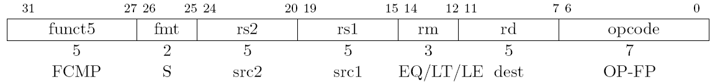
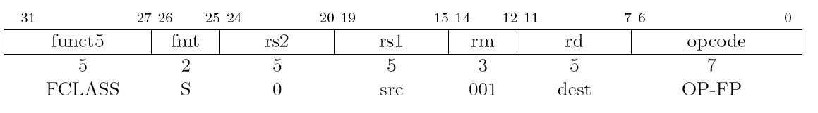
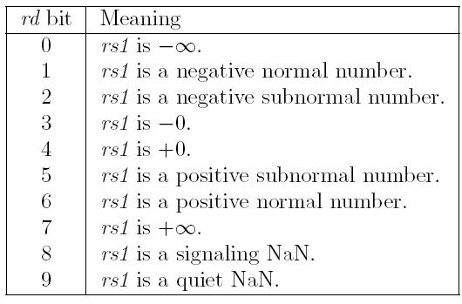
Single-Precision FP Compare/Classify Instructions

Slide 9
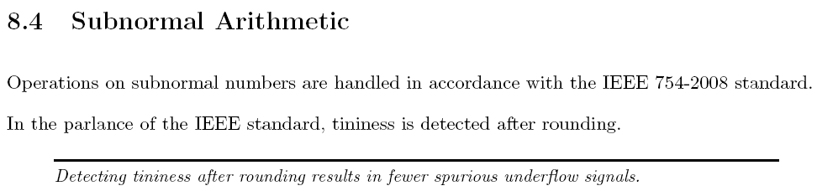
Subnormal Arithmetic

Slide 10
Reuse GW FPU for Vicuna Options
MUL unit flopped at level 4
Option 1: pipeline for MUL ➔ MAC:12 ,Add 6
4 stages for MUL unit
Addition latency = 6
Option 2: stall by MUL ➔ MAC:10~12, Add 4~6
MUL CSA level 1 to level4 run at F1 stage
MUL CSA level 5 to level7 run at F2 stage
Stall FPU pipeline (MUL busy)
The MUL result feed back to level1 and run again
Option 3: ➔ MAC 6x2=12 cycles
core_clk : fpu_clk = 2:1

Slide 11
GW FPU Function Unit timing
 | Frequency (MHz) | Period (ns) | Area (Kgates) | Uncertainty (> period*0.3) | Note
GW FPU | 749 | 1.334 | 77.86K | 0.3 | Adder+rounding(F3)
53-bit adder | 1620 | 0.617 |  | 0.3 | Met (for F3 far path)
110-bit adder | 1531 | 0.653 |  | 0.3 | Met (for F2 near path)
MUL unit original | 987 | 1.013 |  | 0.3 | X
MUL flop L5 | 1179 | 0.848 | 54.6kK | 0.252 | X
MUL flop L4 | 1428 | 0.700 | 54.07K | 0.215 | Met (total 7 level CSA)
MUL flop L3 | 1262 | 0.792 |  | 0.3 | X, critical: sticky=|(sum+cout)
DSU original | 1098 | 0.910 | 11.48K | 0.3 | X
DSU original | 1213 | 0.824 | 11.43K | 0.215 | Met Vicuna Not met Aries
DSU flop | 1262 | 0.792 | 6.53K | 0.3 | Met Vicuna Not met Aries
DSU flop | 1451 | 0.689 | 6.42K | 0.2 | Met
At F3, Adder result should be flopped than sent to Rounding
The most critical path of original GW FPU design => 794MHz

Slide 12
Option1
frs0_index
Register File
frs1_index
I2
frs2_index
GW FPU
forwarding_data
Special value
Detection
Unpacking
F1
mul_result
F1
MUL1
Exp & Signed
EXP_DIFF and swap
MUL/DS
ieu_fpu_rs_data_f1
F2
MUL2
F3
F2
MUL/DS
MUL1
Special value
Exp adjust
Determine signed
shifter
Alignment
F4
fpu_iru _exception_f2
MUL2
Adder/LZA
F5
F3
Normalization
Adder and rounding critical path
ieu_fpu_rd_data_f3
F6
Exp adjust
shifter
shifter
OVF/Tiny
mul_result
exception
Packing
fpu _frd_data_f3

Slide 13
Option2
frs0_index
Register File
frs1_index
I2
frs2_index
GW FPU
forwarding_data
Special value
Detection
Unpacking
F1
mul_result
Exp & Signed
EXP_DIFF and swap
MUL/DS
ieu_fpu_rs_data_f1
F2
MUL/DS
Special value
Exp adjust
Determine signed
shifter
Alignment critical?
fpu_iru _exception_f2
Adder/LZA
F3
Normalization
Adder and rounding critical path
ieu_fpu_rd_data_f3
F4
Exp adjust
shifter
shifter
OVF/Tiny
mul_result
exception
Packing
Mul run twice, total 4 cycles
fpu _frd_data_f3

Slide 14
SD MAC FPU Referenced Paper
Architectural Design of a Fast Floating-point Multiplication-Add Fused Unit Using Signed-Digit Addition
Chichyang Chen, Liang-An Chen and Jih-Ren Cheng
Published in: IEE Proceedings - Computers and Digital Techniques ( Volume: 149, Issue: 4, Jul 2002 )

Slide 15
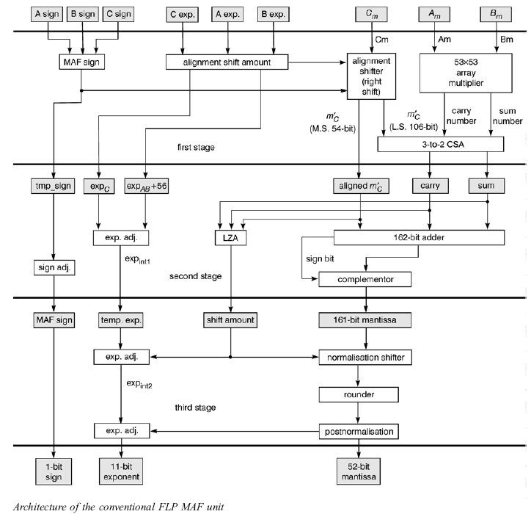
Conventional
FLP MAF unit

Slide 16
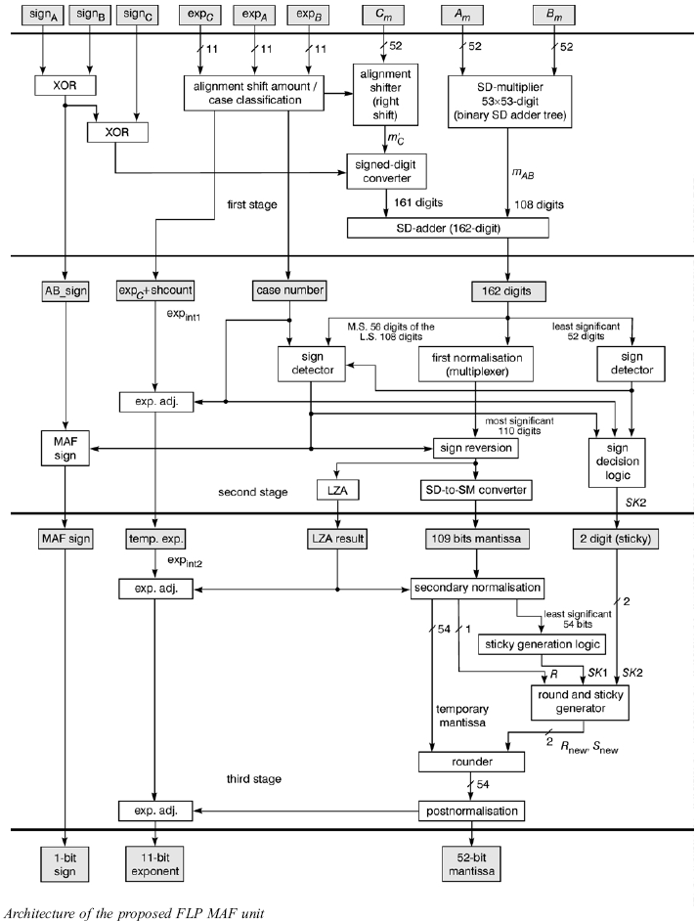
Signed-Digit FLP MAF unit
MAC: 4~7 cycles
Add: 4~7 cycles

Slide 17
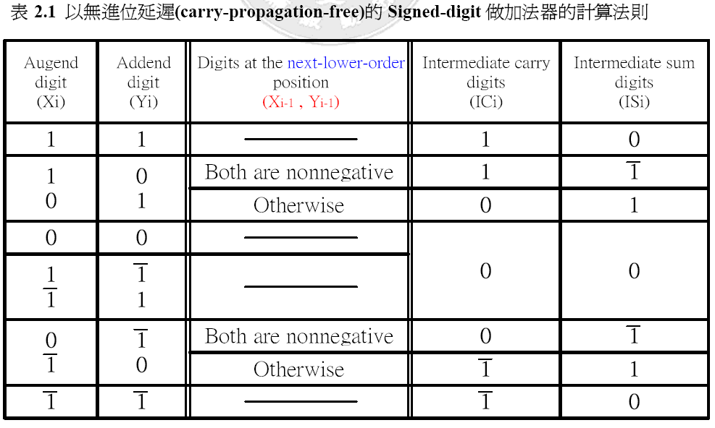
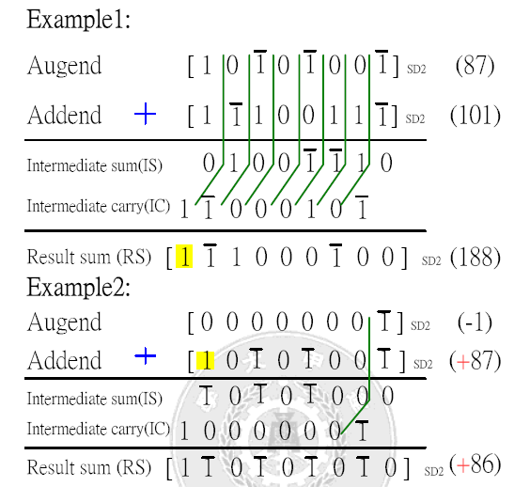
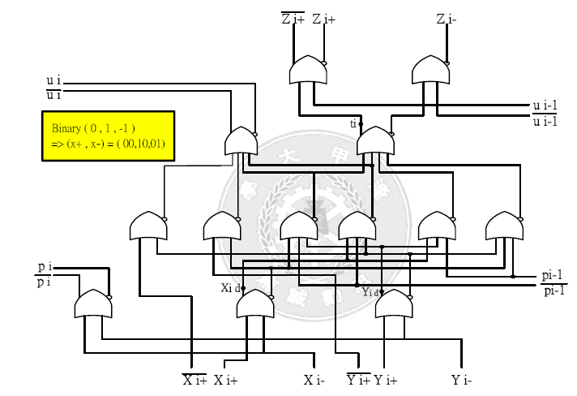
Signed Digit Number System

Slide 18
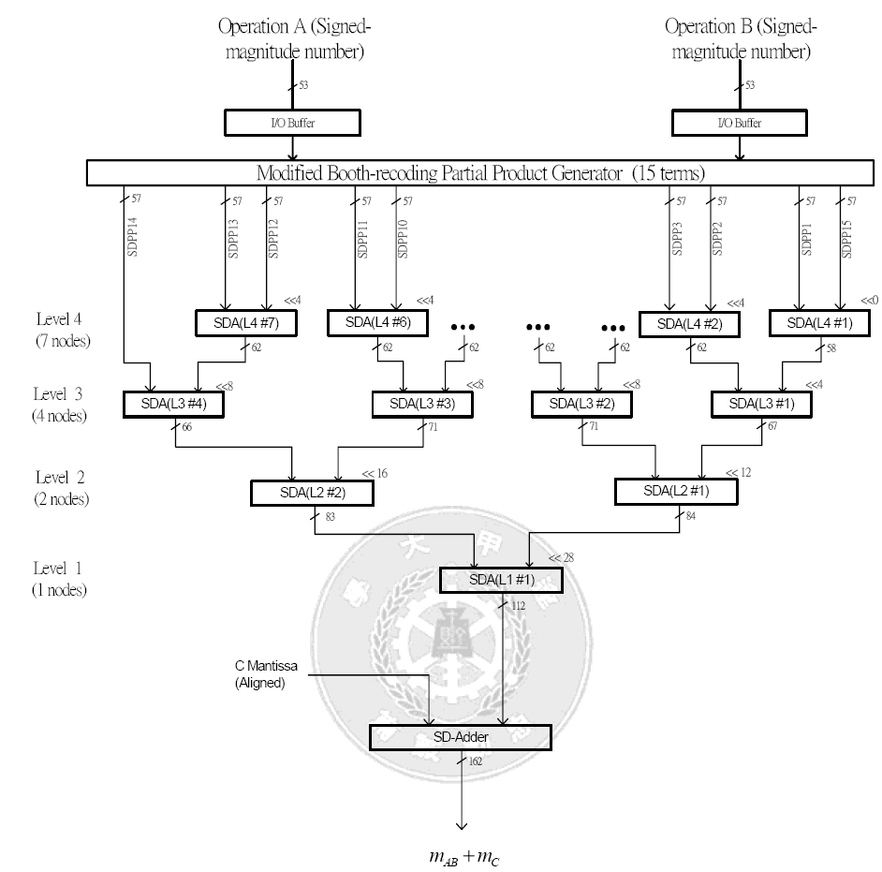
1
2
3
4

Slide 19
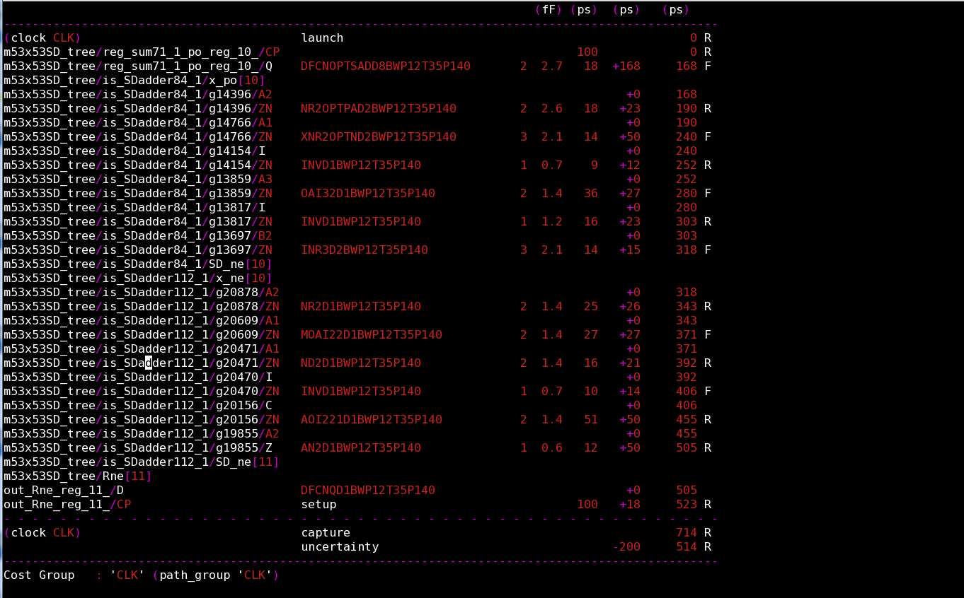
Level 3 and Level 4 SD Adder of MUL

Slide 20
SD 53x53 MUL timing
 | Frequency (MHz) | Period (ns) | Area (Kgates) | Uncertainty (> period*0.3) | Note
SD m53x53 Original (4Level) | 961.54 | 1.04 | 34.58k | 0.3 | n28_12t_RVT
SD m53x53 flop Level3 | 1070 | 0.934 | 38.29K | 0.3 | n28_12t_RVT
SD m53x53 flop Level2 | 1383.13 | 0.723 | 45.84K | 0.2 | n28_12t_RVT
SD m53x53 flop Level2 | 1715.27 | 0.583 | 46.02K | 0.2 | n28_12t_LVT

Slide 21

Thank You!
www.andestech.com

Slide 22
Thank You!

Slide 23
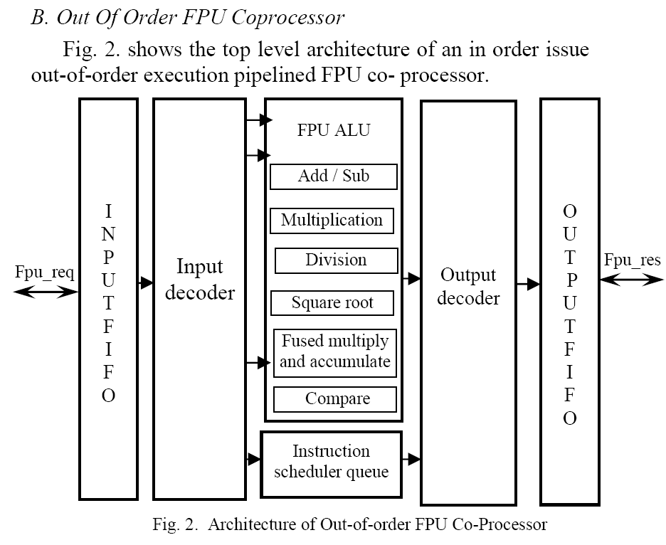
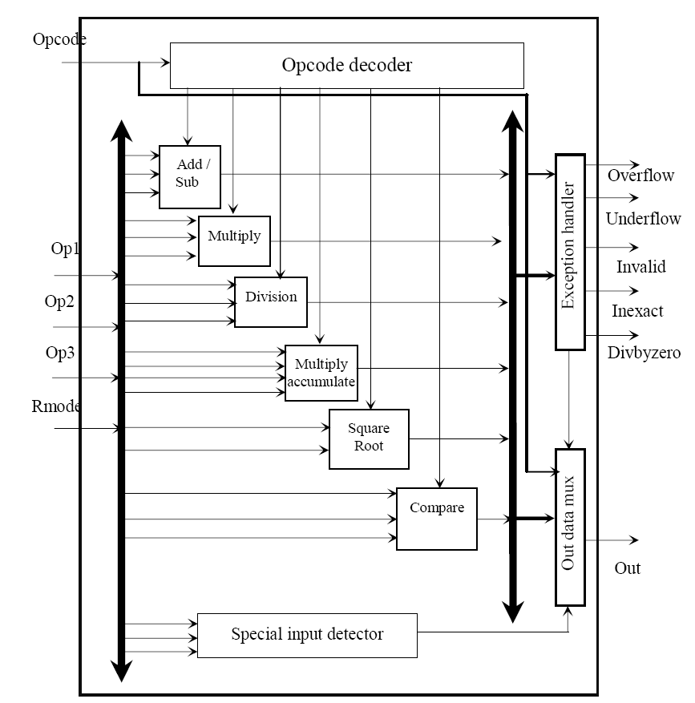
Survey Papers
Out of order floating point coprocessor for RISC V ISA
Published in: VLSI Design and Test (VDAT), 2015 19th International Symposium on
Date of Conference: 26-29 June 2015

Slide 24
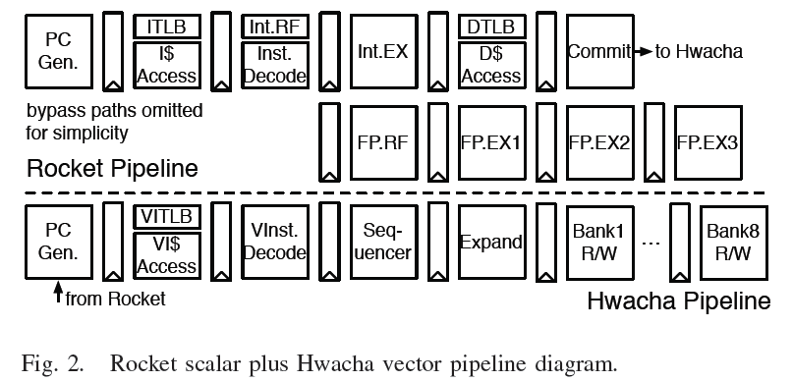
Survey Papers
A 45nm 1.3GHz 16.7 Double-Precision GFLOPS/W RISC-V Processor with Vector Accelerators
Published in: European Solid State Circuits Conference (ESSCIRC), ESSCIRC 2014 - 40th

